Slide 1
C++ STRING – PROJECT

Slide 2

Who are we?
Petar Stoev
Class: 9a
pkstoev18@codingburgas.bg
Kaloyan Yordanov
Class: 9b
kyayordanov18@codingburgas.bg
Viktor Kavaldjiev
Class: 9v
vgkavaldzhiev@codingburgas.bg
Plamen Petkov
Class: 9g
Pcpetkov@codingburgas.bg

Slide 3
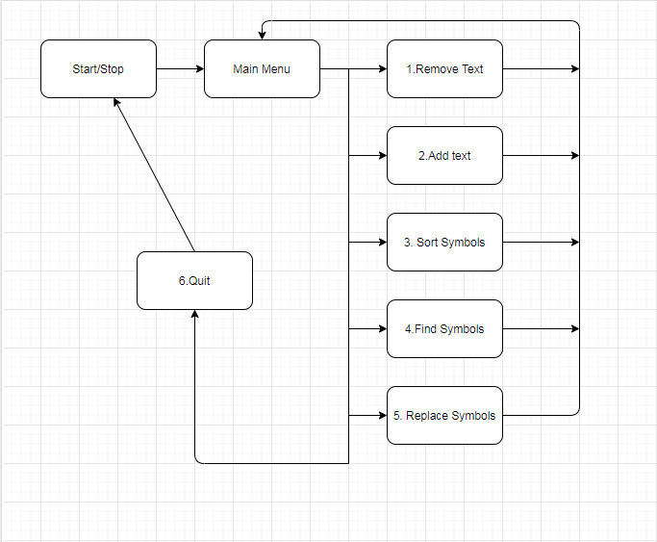
Chart of our program.
A simplified flowchart of the programme:

Slide 4




Used programming language and programs:
Programs:
Visual Studio - that is the IDE where we wrote the code
Git hub - this is the platform for committing and keeping the code
Discord - we used it for calls, collaboration and teamwork
C++ - that is the programming language that we used to write our code

Slide 5
Improvements?
Are improvements possible?
Yes of course!
Are we going to improve our code?
Yes it is very possible.
How are we going to improve our code.
1st we can add more functions.
2nd we can make a log in menu to remember the user that often uses our programme
3rd we will try our best to spread the programme to all countries in Europe and then the other continents.
What’s our dream?
Our dream is that our programme becomes very popular and be able to help a lot of people across the world and maybe make them more close to each other!

Slide 6
Thanks for the attention!
Time for questions?

